Slide 1
Slang and Logika Overview
STRESS 2024 – October 24, 2024
Kansas State University
Aarhus University
Robby
John Hatcliff
Jason Belt
Stefan Hallerstede
This material is based on research sponsored in part by DARPA
DISCLAIMER: The views and conclusions contained in this presentation are those of the author and should not be interpreted as representing the official policies, either express or implied, of any agency or department of the U.S. Government, Kansas State University or Aarhus University
Notes:
I'm John Hatcliff, a professor from Kansas State University. This is a second talk on semantics for a modeling language, and here we aim to make deeper connections with the underlying application and infrastructure code via contracts. This talk pulls together several different lines of work that were carried out in collaboration with different teams, including teams from SEI and Galois primarily, but always folks from Collins Aerospace and people working on seL4.

Slide 2
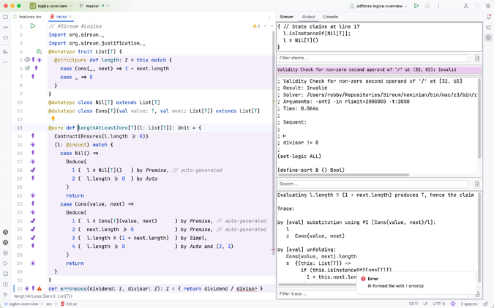
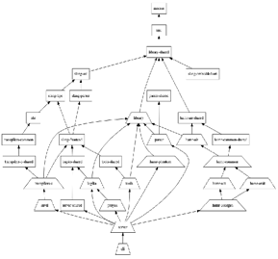
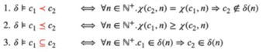
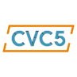

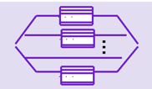

Slang & Logika
Slang - safety-critical subset of Scala + integrated contract and proof language
Logika - compositional contract checking via scalable incremental symbolic execution
Incremental Evaluation
Logical Constraints
SMT Solvers
Server-based Architecture
…
IntelliJ IDE integration

Slide 3

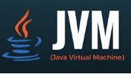
Slang-based Development
Integrates with JVM-based languages and libraries
A safety-critical subset of Scala with tailored (simplified) semantics
Retains Scala blending of imperative, functional, and OO paradigms
Compiles to JVM bytecode, Javascript, and native
Rich IDE support
Interoperable with huge collection of libraries in Java/Scala ecosystem

Slide 4
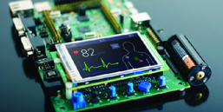

Slang-based Development
Slang Embedded profile – supports industrial embedded system development
Translation to C99
No garbage collection at runtime (only global & stack allocations)
Can be compiled using gcc, clang, and the CompCert Verified C compiler
Translation to Rust
under development with Collins Aerospace and Aarhus University (Stefan Hallerstede)
Contract verification with CMU Verus Rust verification tool
(in progress)

Slide 5
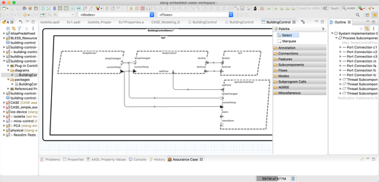
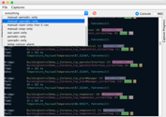
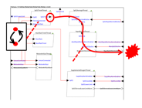
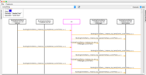


HAMR – Model-driven Developemnt
One of the industry-relevant applications of applications of Slang & Logika
Leveraging analyses from AADL community
Modeling, analysis, and verification in the AADL modeling language
(+ SysMLv2 Prototype)
Component development and verification in multiple languages
C
Slang (developed at Kansas State)
high integrity subset of Scala
contract verification framework
translates to C
translates to Rust (upcoming)
Rust (upcoming on DARPA PROVERS)
Deployments aligned with AADL run-time on multiple platforms
JVM Deployment
Linux Deployment
seL4 Deployment
verified micro-kernel
Notes:
The framework that we will be using for this work is HAMR -- a model-driven development tool chain for high assurance embedded systems that emphasizes three layers of development:
Modeling, analysis and verification in the AADL modeling language, leveraging many tools in the AADL ecosystem
Development of component application logic in multiple languages include C and Slang (a safety-critical system of Scala with a contract verification framework, which can be translated to C)
Deployments on multiple platforms including seL4 verified microkernel.

Slide 6
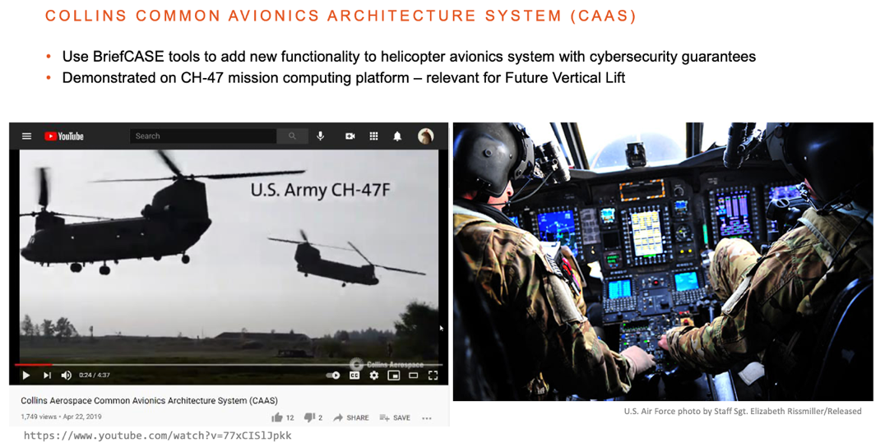
HAMR – Collins Aerospace
Collins technology stack (including HAMR) used to add new cyber-resilient functionality to CH-47 military helicopter mission computing…
Detailed journal paper on HAMR with seL4 backend
Jason Belt, John Hatcliff, Robby, John Shackleton, Jim Carciofini, Todd Carpenter, Eric Mercer, Isaac Amundson, Junaid Babar, Darren Cofer, David Hardin, Karl Hoech, Konrad Slind, Ihor Kuz, Kent Mcleod. “Model-Driven Development for the seL4 Microkernel Using the HAMR Framework”. Journal of Systems Architecture. Volume 134, January 2023
Notes:
The framework that we will be using for this work is HAMR -- a model-driven development tool chain for high assurance embedded systems that emphasizes three layers of development:
Modeling, analysis and verification in the AADL modeling language, leveraging many tools in the AADL ecosystem
Development of component application logic in multiple languages include C and Slang (a safety-critical system of Scala with a contract verification framework, which can be translated to C)
Deployments on multiple platforms including seL4 verified microkernel.

Slide 7
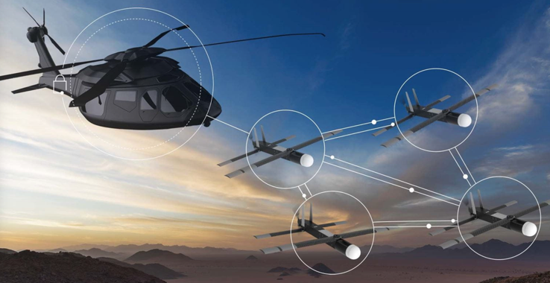
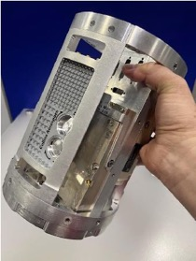
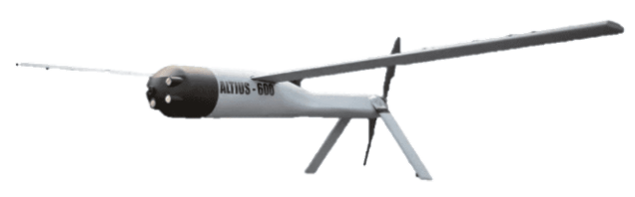

HAMR – Collins Aerospace
On DARPA PROVERS, HAMR is being used to develop an experimental version of the infrastructure for Collins “Air Launched Effects” platform that provides increased modularity and security --- (final development will be SysMLv2 to Rust)
Current - Mission computer for UAVs collaborative UAVs
Video:
https://youtu.be/SwPJHmZQMaM?si=NwTdb3VFpV-MxSre
Notes:
The framework that we will be using for this work is HAMR -- a model-driven development tool chain for high assurance embedded systems that emphasizes three layers of development:
Modeling, analysis and verification in the AADL modeling language, leveraging many tools in the AADL ecosystem
Development of component application logic in multiple languages include C and Slang (a safety-critical system of Scala with a contract verification framework, which can be translated to C)
Deployments on multiple platforms including seL4 verified microkernel.

Slide 8

Slang Is Part of Sireum
A collection of infrastructure and tools for high-assurance system development from Kansas State (led by Prof. Robby)
Slang (the Sireum Language)
Logika – symbolic execution-based verifier for Slang
HAMR -- model-driven development for AADL & SysMLv2
IVE – IntelliJ and VSCode plug-ins for HAMR, Slang, Logika
Slang to C/Rust transpilers
Proyek – build system
Language processing infrastructure (ASTs, parsing, type-checking, etc.)
…

Slide 9
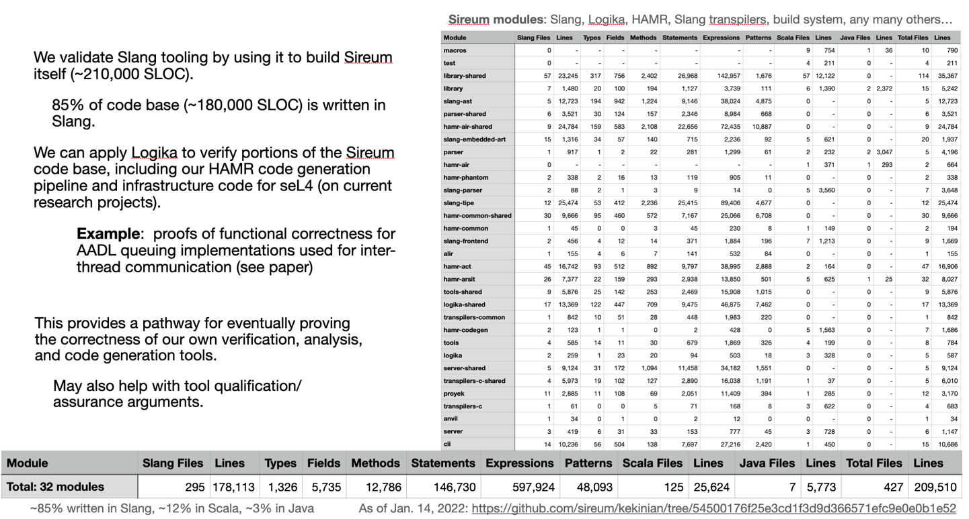
Most of Sireum is Implemented in Slang
Over 180K SLOC of Sireum is implemented in Slang

Slide 10
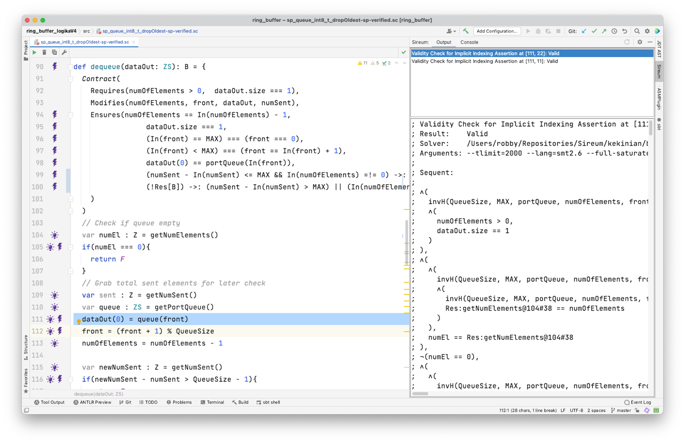
Slang Contracts and Automated Verification via Symbolic Execution (Logika)
DARPA SBIR w/
Galois
Slang – high-integrity subset of Scala + Logika verification in IntelliJ IDE
Slang Contract
Drill down display for verification conditions and SMT interaction
Application Code
Verification Drill-down Controls
Slang applications can be integrated with Scala and Java and executed on JVM or transpiled to JS or C. The generated C has bounded memory usage and no garbage collection & compatible with verified CompCert compiler.
Notes:
Here’s a quick look at Slang verification concepts, in additional to your application code, you can have
[click]
behavioral contracts which are automatically verified using symbolic execution and SMT solvers. The Slang verification environment is really user-friendly – for example, although verification is largly automatic – guided by a few annotations,
[click]
you can drill down in multiple ways to see the deductions going on behind the scenes and to see the underlying interactions with the SMT solver.
Even the the Slang to C translation is not yet proven correct, the generated C code is compatible with the verified CompCert C compiler, so we are laying the foundation for extending the verified translation stack up through the layers of abstraction.

Slide 11
Logika – Distinctive Features
Significant engineering effort devoted to…
Presenting verification information (specs, results) directly in terms of programming language features
Integration into developer workflows
Optimizations for usability and scaling
“Always on”, Incremental checking
Parallelization, server-based architecture
Integrated proof language
Blending SMT and Interactive Theorem Proving
Integrated into a broader vision for model-based development of critical systems using industry standard modeling languages (AADL, SysMLv2)
Pedagogical Features
A number of “extras” to support teaching of formal methods and program reasoning

Slide 12
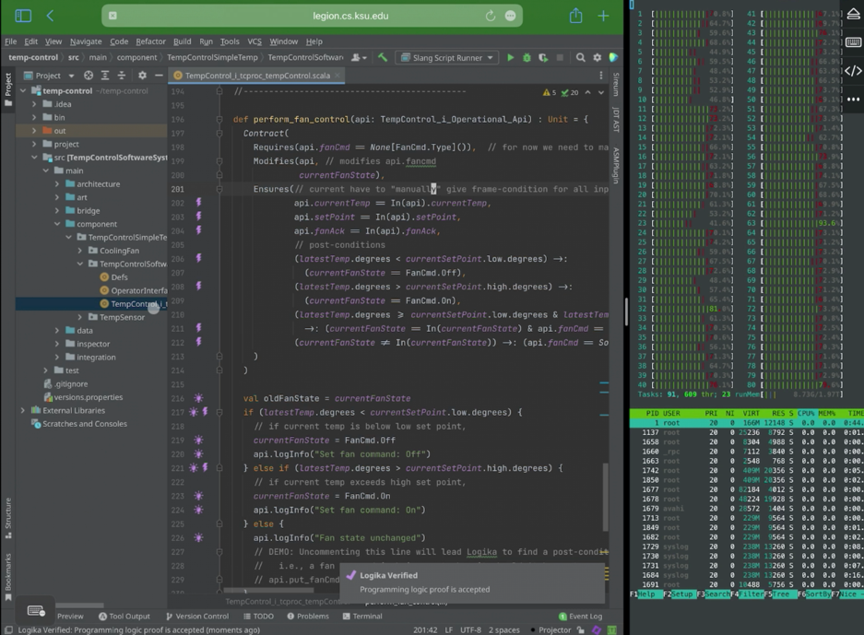
Logika Verification Featureful, Integrated Capabilities
Logika has a server-based architecture with a suite of SMT solvers (Z3, CVCx, Alt-Ergo), uses massive parallelization, with “always on” smart incremental checking
Logika verification of Slang code in IntelliJ IDE on iPad
...connected to 80-core server to run verification
From a TCCOE conference demo video of Logika in January 2022
See https://drive.google.com/uc?export=download&id=1vkBNWM8pocSz8jUG-E16zdVleELZr2Sk
for Slang / Logika overview talk given at the Trusted Computing Center of Excellence Symposium

Slide 13
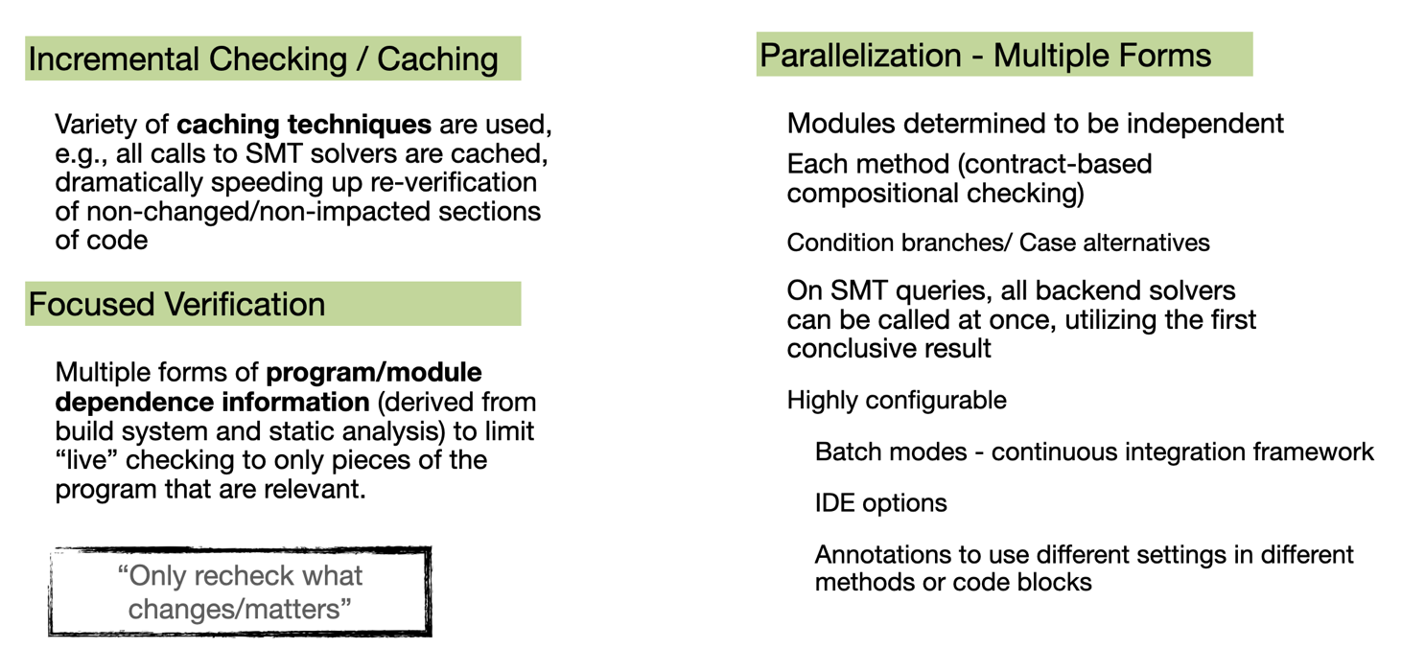
Logika Scalability Strategies
For technical details, see included paper “Logika Overview”…

Slide 14


Proven in Teaching
See included paper on experience at Aarhus
Undergraduate Course at Kansas State
Aarhus University -- Denmark
Used in required course Logical Foundations of Programming
Over 2000 undergraduates during past seven years
Logika is being used in both undergraduate and graduate courses at Aarhus University
Undergraduate Course at Kansas State
Model-based Development for High-Assurance Systems (e.g., medical device development)
Software Specifications

Slide 15
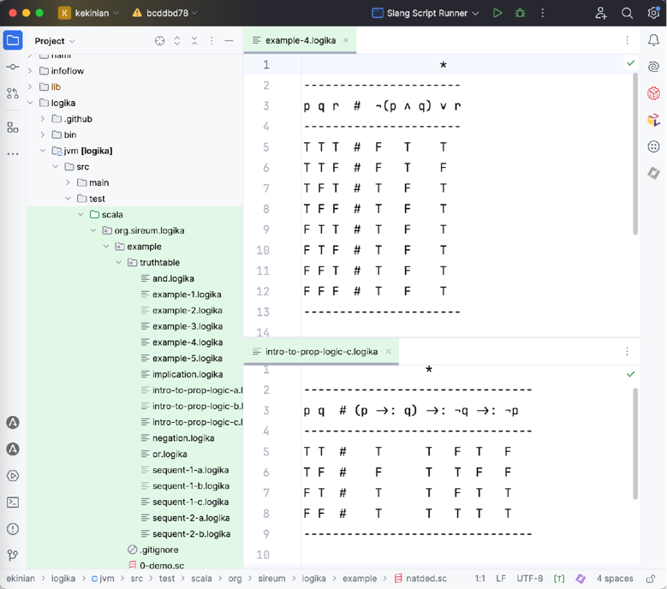
Pedagogical Support
Support for editing and checking Truth Tables
Logika provides a dedicated editor for truth tables
Enables transition from learning the semantics of logic formulas to …
Natural Deduction proofs
Program Logic with manual proofs based on Natural Deduction
Automated program reasoning
See misc-examples/truth-tables

Slide 16
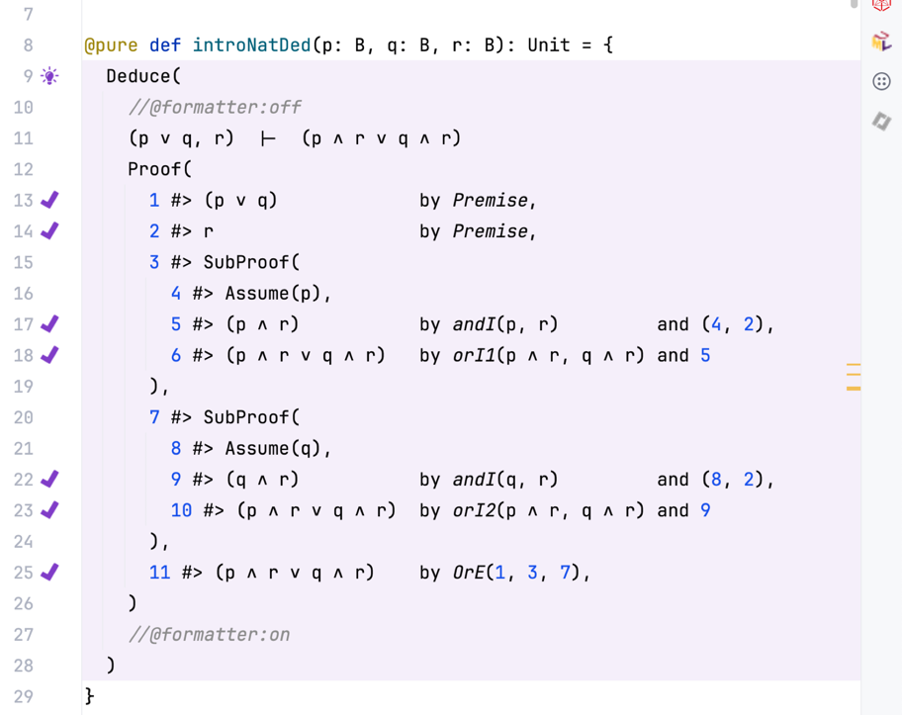
Pedagogical Support
Support for specifying and checking natural deduction proofs for first-order logic
Sequent to prove
Natural Deduction proofs are entered in a format deliberately designed to emphasize connections to programming.
Claim
Justification
Logika correctness checks
See misc-examples/natural-deduction

Slide 17
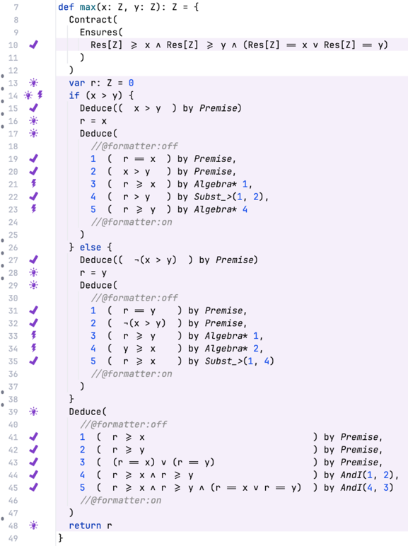
Pedagogical Support
Program verification with natural deduction and basic reasoning steps
Students are first taught to reason about program constructs using Hoare triples and basic reasoning steps…
…before moving to automated verification
Algebra (numerical expression simplification)
Substitution
Logika correctness checks
Natural Deduction
See misc-examples/natural-deduction

Slide 18
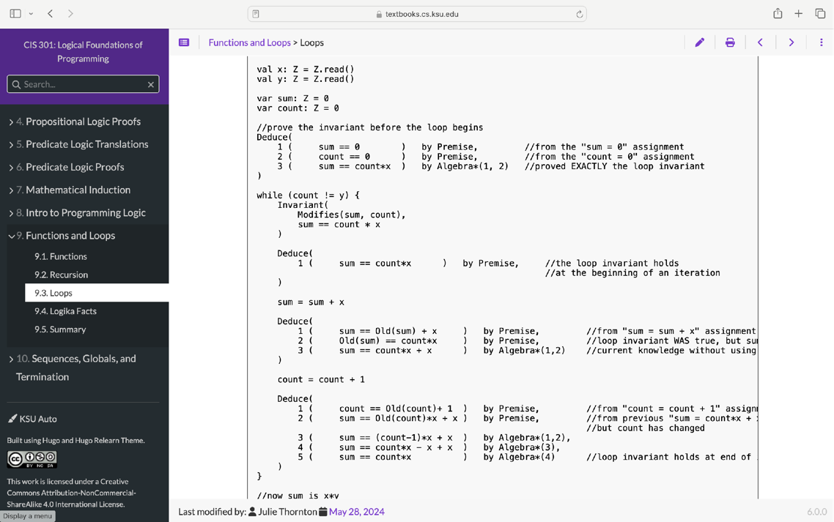
Free Online Textbook
This textbook emphasizes basics of logic and manual program proofs
See https://textbooks.cs.ksu.edu/cis301/

Slide 19
Lecture Outline

Slide 20
Session Schedule
Morning 01 (M-01)
Logika Basics
Morning 02 (M-02)
Proving properties of loops, sequences, etc.
Afternoon 01 (A-01)
Advanced Logika
Induction
Rewriting
Afternoon 02 (A-02)
Model-driven development with contracts

Slide 21
M-01 Logika Basics
Overview of the Sireum Integrated Verification Environment
Slang Contract
Drill down display for verification conditions and SMT interaction
Application Code
Verification Drill-down Controls

Slide 22
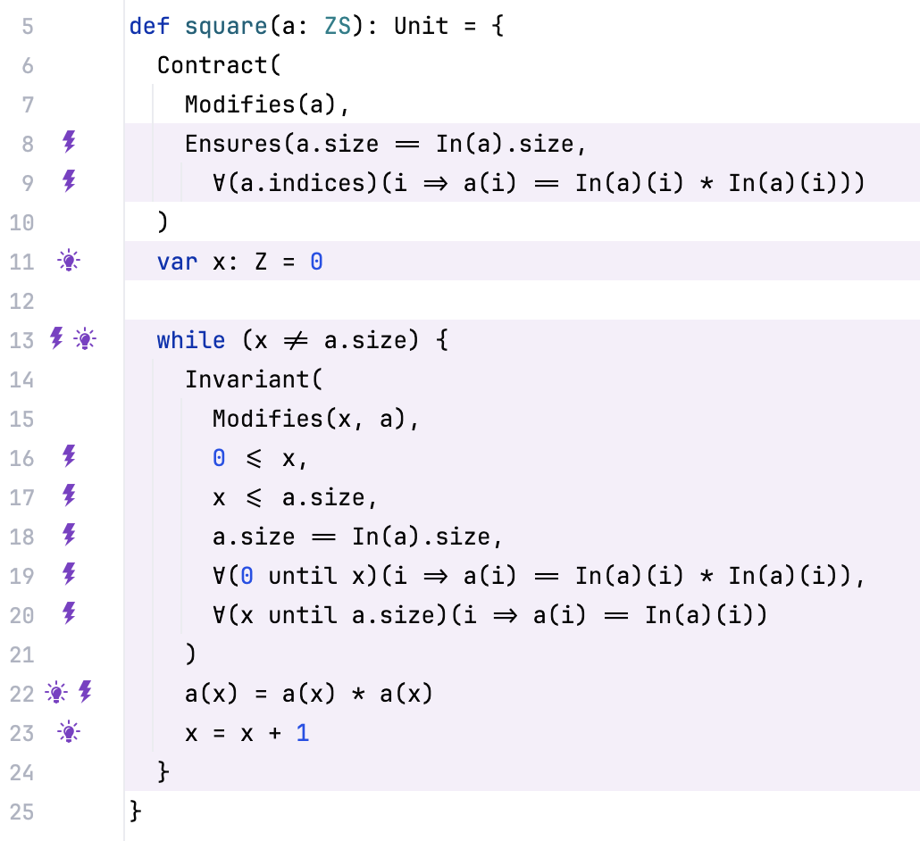
M-01 Logika Basics
Verification concepts for assignment statements, conditionals, and method calls
Principles of method contracts and assume/guarantee reasoning

Slide 23
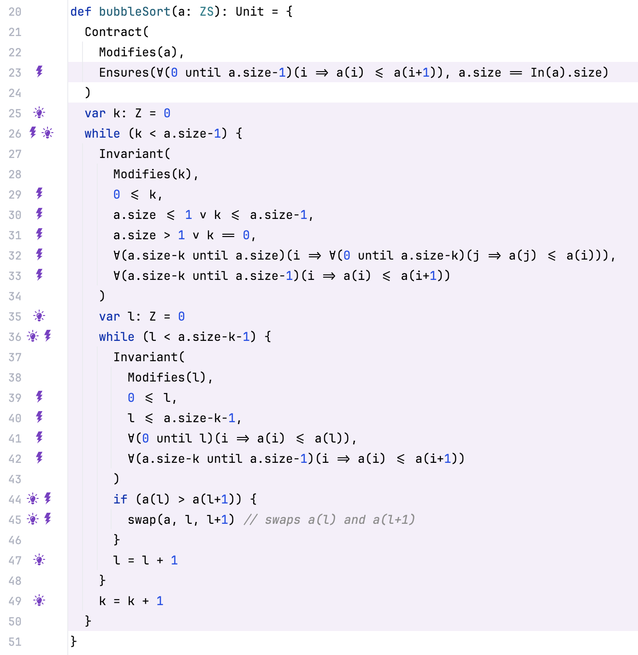
M-02 Verification of Loops, Sequences
Verification concepts for loops, loop invariants, quantification over sequence elements
Loop invariants
Quantification over sequence elements.
Sorting algorithms

Slide 24
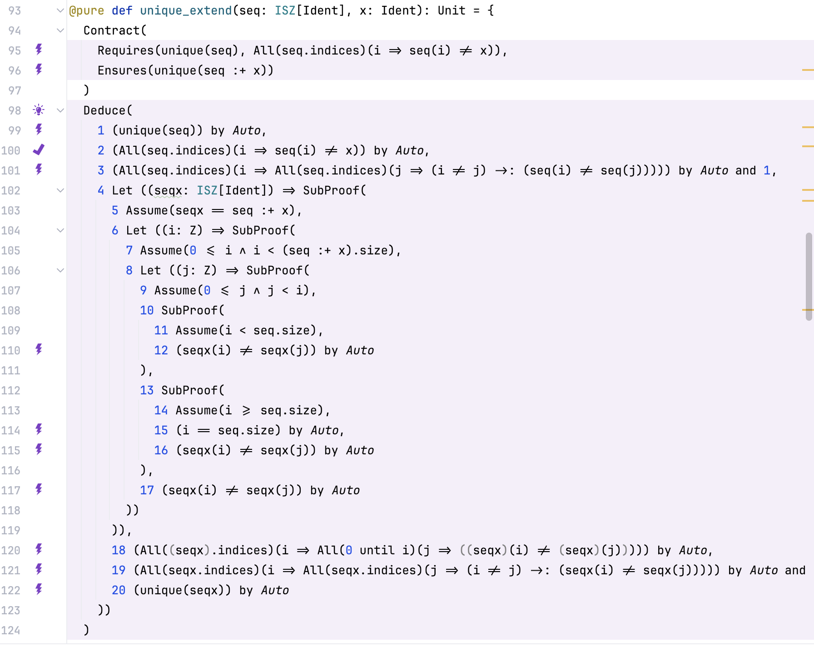
M-03 Logika Induction, Rewriting, etc.
Verification capabilities that no other program verifier supports…
Mixing manual proof steps with automated SMT verification in programmer-friendly notations and environment
Nested proofs in integrated proof language

Slide 25
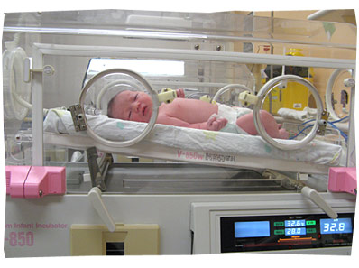
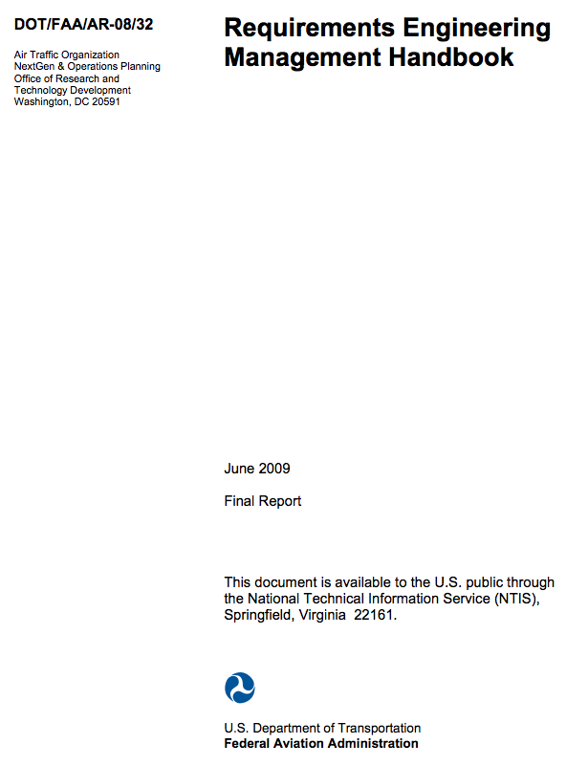

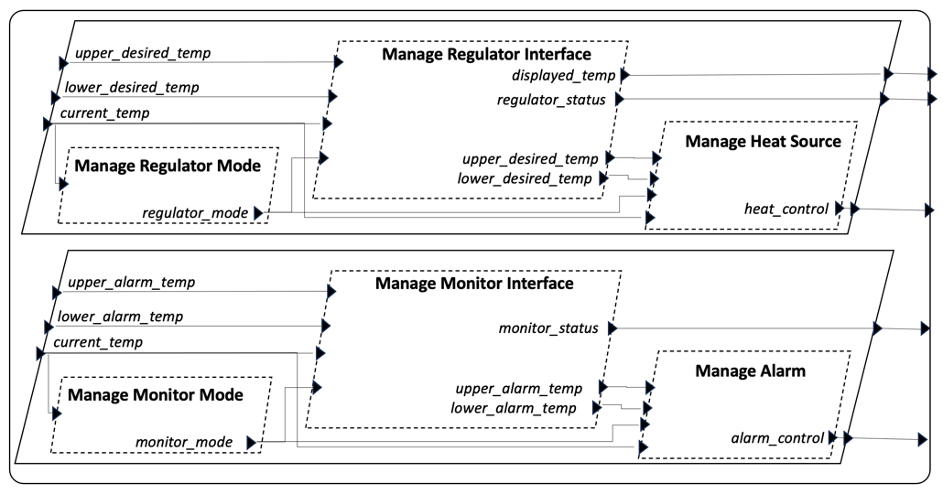
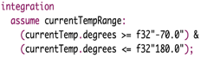
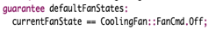
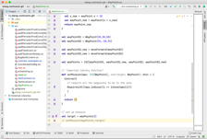
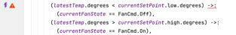
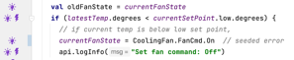
M-04 Model-Driven Development for Embedded Systems
Integrated verification at the model and code levels…
Requirements from NASA FAA Requirements Engineering Management Handbook
Isolette (infant incubator)
AADL-Level Contracts
Automated Code Generation in HAMR
Contract Translation
and Embedding / Weaving
Code-Level Logic-based Contracts
Formal AADL & SysMLv2 Models

